Slide 1
Charged Attack

Slide 2
week 2
What will I focus on developing?
Smooth charge attack, with damage collider to feel meaningful. Have Number pop up when dealing damage to get a sense of the charge effect.
What do I want to have done by next week 2?
Numbers pop up when you deal damage. To find an animation to help the attack smoothness. Collider for damage dealing fixed for attack strike.
What individual steps or tasks must I go through?
Research tutorials for UI related scripts for getting numbers to pop up when strike.
Fiddle with the collider for comfort.
ASK Arthur to help.
What order should those tasks go in?
3 tasks, collider 1st coupled with research. Then make scripts for UI then ask Arthur.
How long do you think it would take you to complete each one.
Research can be done on weekend Saturday morning and Sunday DAY.
The script can be made on Tuesday morning.
Then Arthur to help complete the task is on Thursday at noon.

Slide 3
COMPLETE_ just script not working… week 3
Definitely sticking with my old project for a hack n slash to CHARGING an attack…
What I did this week, research for UI script, numbers when strike, got basics but not working as intended.
Did fix the weapon collider, works well.
I think it needs charged attack and attack while in motion….
I had an idea, TO have colour change when charging a longer time to accentuate the charge for the aesthetic of quality of life, KILLING with higher dmg.

Slide 4
Product backlog week 4
Have a Camera rig, smooth and responsive to player feedback that is enjoyable on both x/z and y axis, with a scroll. Better than what is it now.
Have another animation, with another attack, to create interest in the charge mechanic usage. Left, and right click.
Have a combo counter, onscreen. Making strings of attacks mean more.
Have a dash that works
Have a super damage barrier that shows numbers
Have a protect shield that has a breakpoint and shows its health, in number and opacity. – not invulnerability.

Slide 5
Order to completion/time spent
Week 4
Camera rig 30 mins – 45 mins
Combo Meter 2-3 hours
Find animation 2 hours
Week 5
Shield 1 hour
Damage barrier 30 mins
Dash 30 mins

Slide 6
Wk5-Product Backlog
NO critical things needed this week-aesthetic
Shield 1 hour
Damage barrier 30 mins
Dash 1 hour
Start Menu 40 mins
Pause Menu 30 mins

Slide 7
Process
I chose to work on existing project from last tri
To minimise my scope, as I have tendencies to over scope
I chose to work on 1 , more of an aesthetic idea to a genre.
CHARGED Attack

Slide 8
The weekly development
Every week I felt I made good progress with how I wanted to tackle this project.
With working on smaller things that add to the genre of hack n slash.
I managed to make it visually appealing with a trail and particles on the weapon.
As well as modifying the basic animations I had to make it feel impactful.

Slide 9
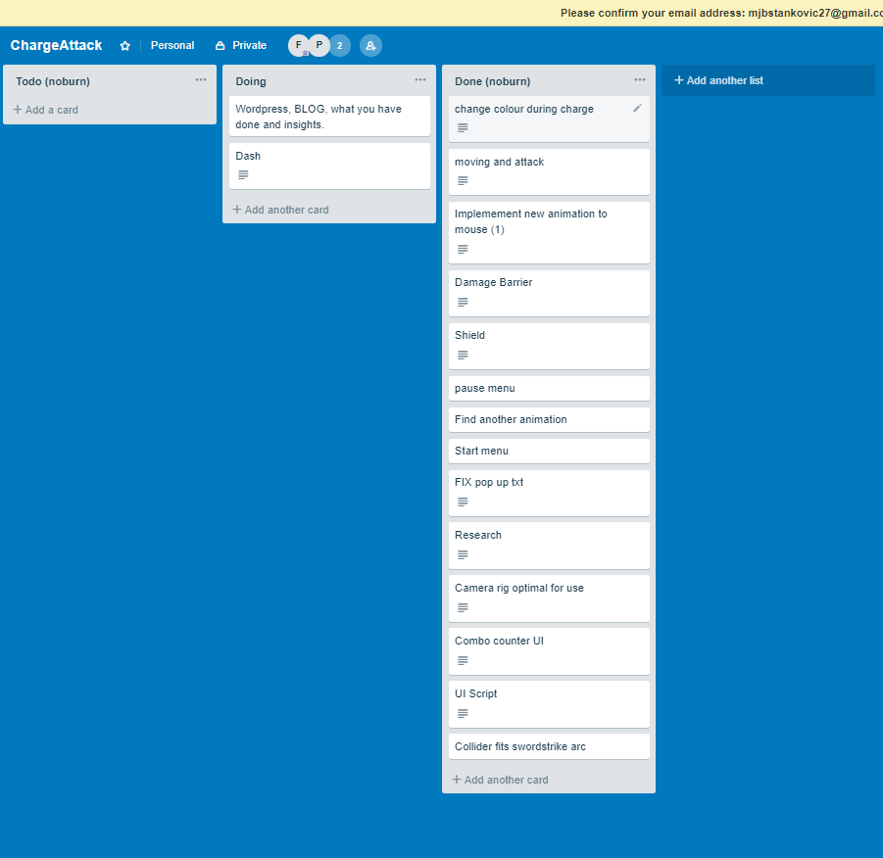
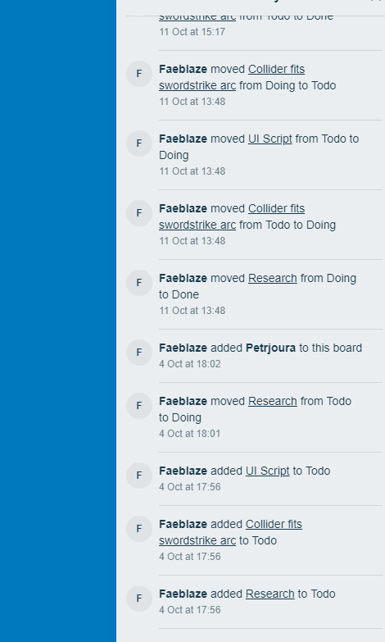
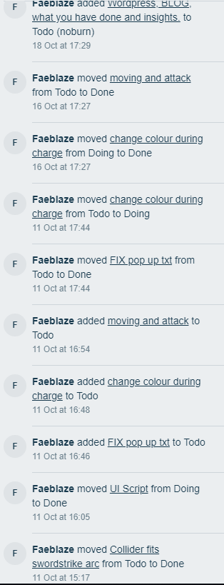
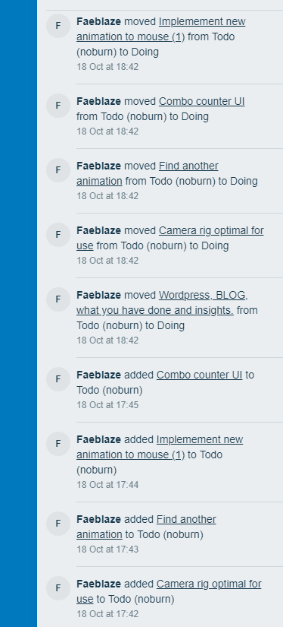
Trello progression

Slide 10
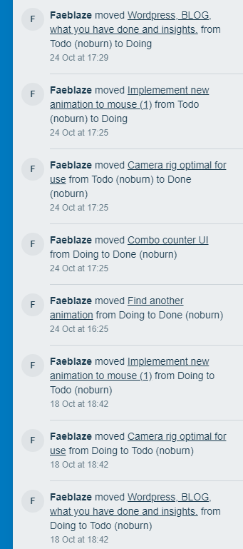
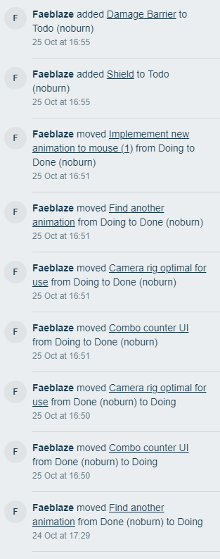
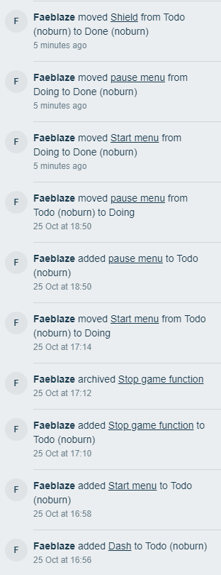
Trello progression

Slide 11
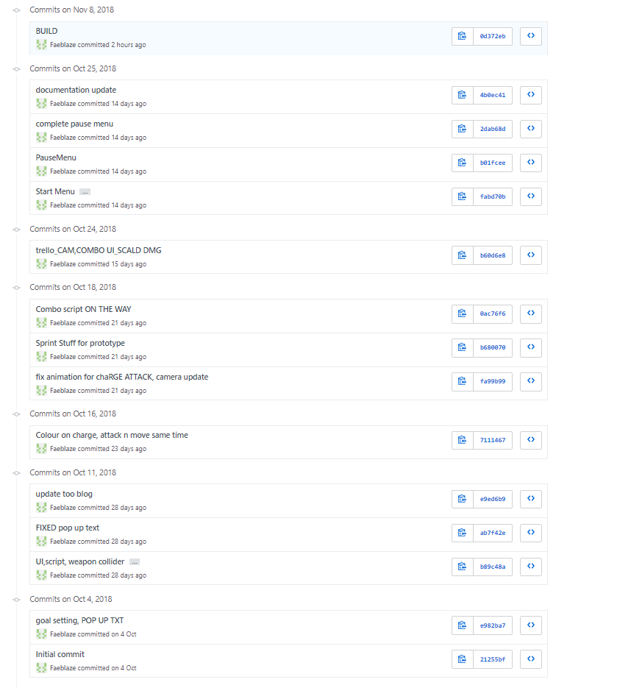
Git hub Commits

Slide 12
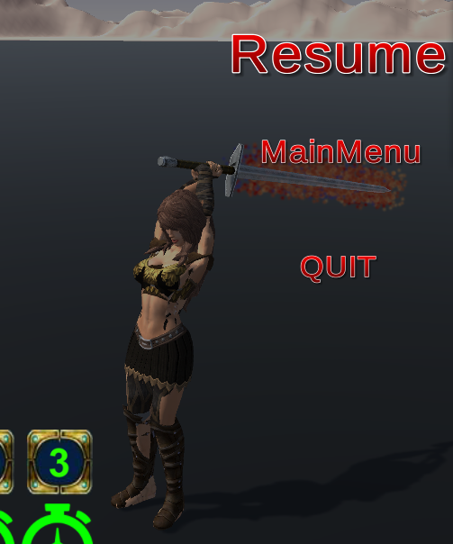
In game progress
Working on the particles for a charged attack.
Also mixing the animations to allow contact with enemies.

Slide 13
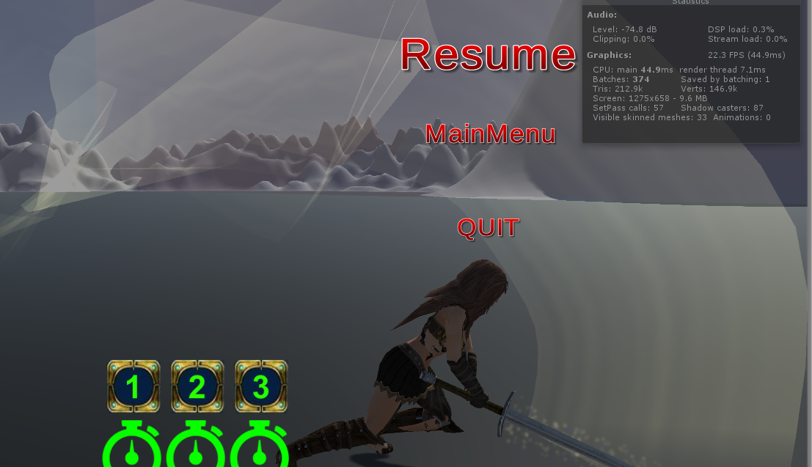
In game progress
Weapon trail on strike and different colours.
Depending on animation and time held the opacity increases increasing impact power

Slide 14
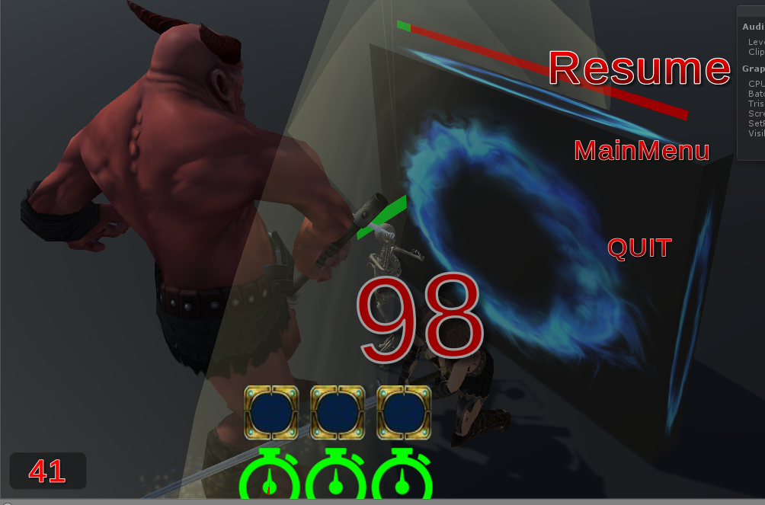
In game progress
The UI at bottom left corner being the combo counter
Also having the damage scale as combo increases. The number UIcoming up on strike as well.

